Slide 1
Stratigraphy of Tertiary Volcanic Rocks in Eastern Nevada
Earl F. Cook
1965
Presented by James McNeil

Slide 2
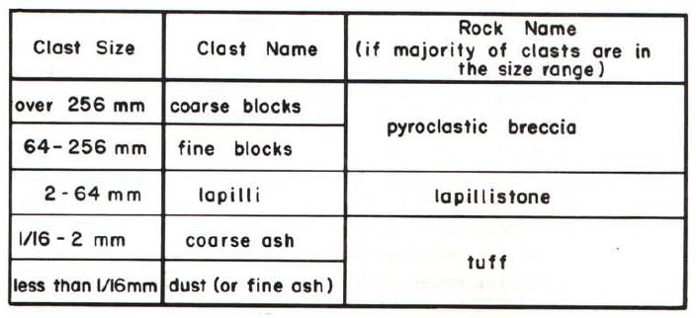
Ignimbrite
Nonsorted sheet-like pyroclastic deposits
Mappable units, not necessarily welded, can be made of material that is not tuff
Nuee Ardente – French – Turbulent, fast moving cloud of hot gas and ash erupted from a volcano
Majority of volcanic deposits in eastern Nevada are ignimbrites

Slide 3
Ignimbrites of Eastern Nevada
Ignimbrites = ~60,000 square miles
Study area = ~20,000 square miles
Individual units traceable over 100 miles
Units cover between 5,000-10,000 square miles
Decrease in age to the south and southeast
Progressive subsidence from central to southern Nevada
Units don’t trend parallel to modern basins and ranges
Notes:
84 volcanic sections, 68 measured
1,300 samples, 800 ground slabs, 100 thin sections

Slide 4
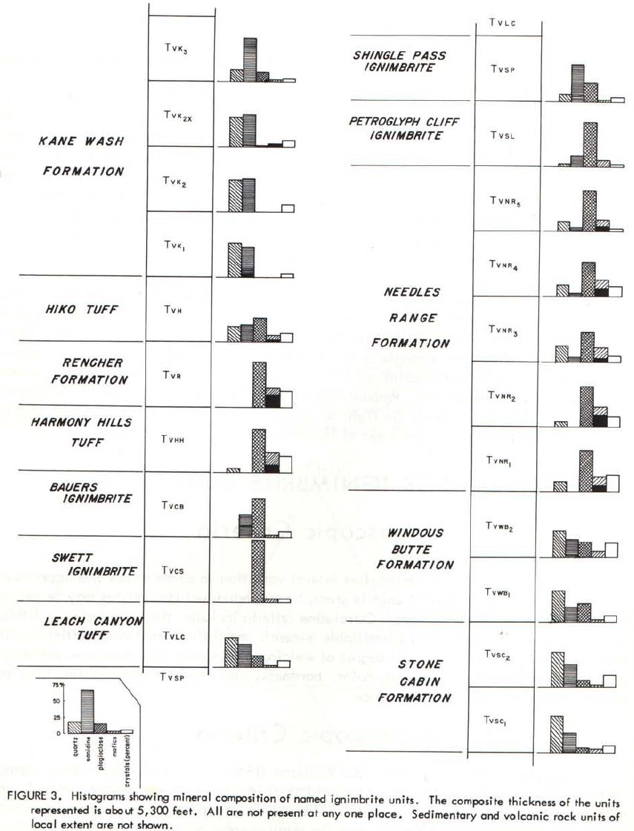
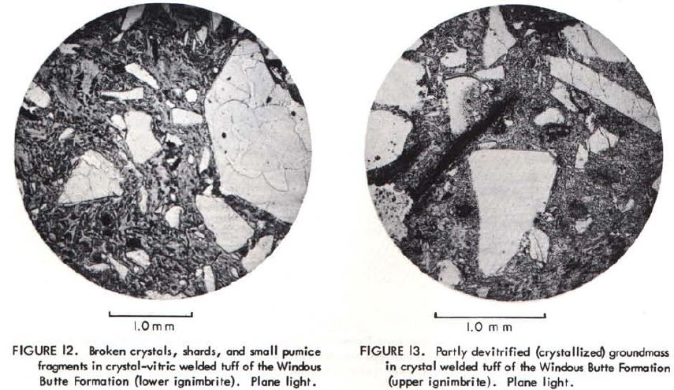
Examples
Composition
q s p m x%
Notes:
Quartz/sanadine/plag/mafics/crystals %

Slide 6
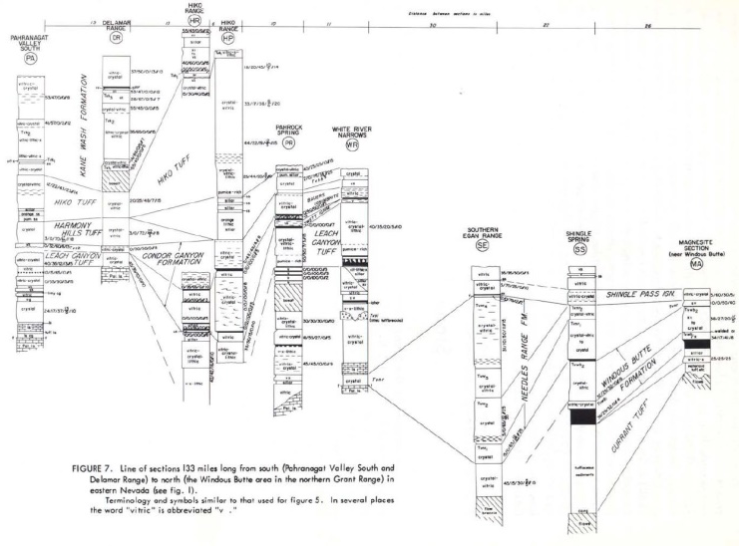
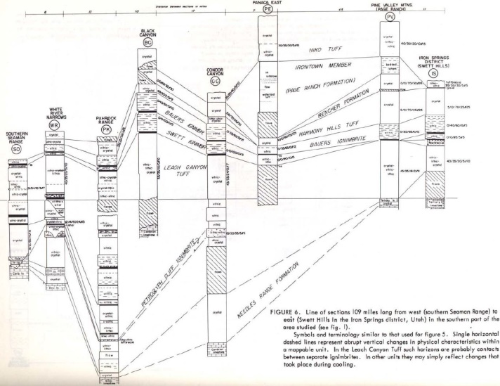
Columnar Sections
Correlation criteria
Ratio between lithic, crystal, and vitric components
Mineral assemblage
Vertical variations and overall degree of welding
133 mi
109 mi
112 mi
Total of 354 mi of section!

Slide 7
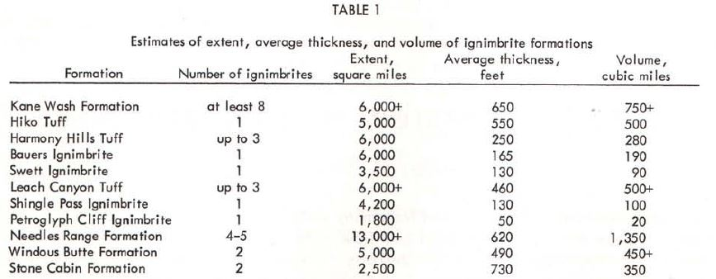
Extent, Average Thickness, & Volume
Variations between crustal thickness and volume
Upper surface of each ignimbrite is horizontal when deposited
Surfaces modified by differential compaction, erosion, or deformation
Ignimbrite extent depends on basin where it was formed

Slide 8
Composition

Slide 9
Textures

Slide 10
Textures

Slide 11
Vertical Variation

Slide 12
Vertical Variation
Welding!

Slide 13
Vertical Variation
Zoning
Top: zone of soft incoherent ash and lapilli with pumice fragments (usually not found)
Gradual transition to thick light to moderately welded zone
OR
Abrupt transition to moderate to highly welded zone

Slide 14
Vertical Variation
Abrupt transition to highly welded dark gray or black vitrophyric zone 10-100 ft thick
Abrupt transition to a nonwelded basal zone of tuffaceous material (few inches to over 100 feet)

Slide 15
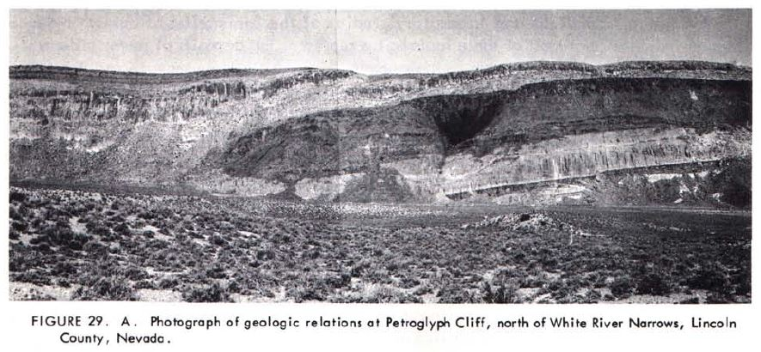
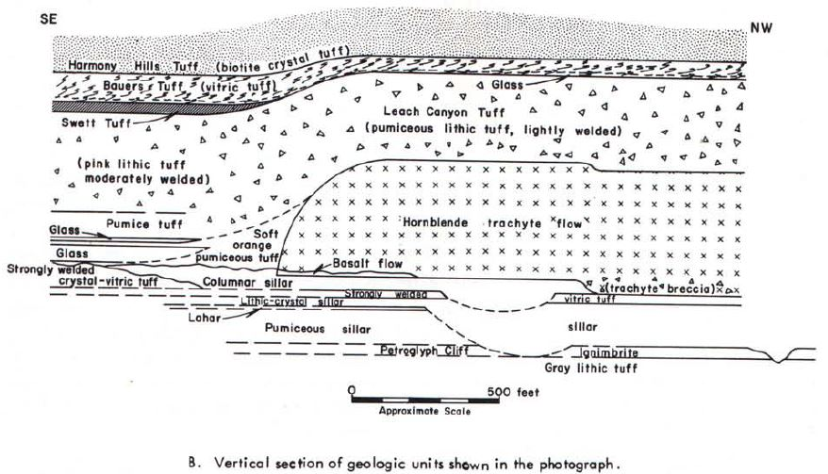
Compaction

Slide 16
Reconstructions
Laramide thrust range
Eastward progression of subsidence resulting from continued deposition of ignimbrites
Migration of eruptive centers could have also played a role in thickness variations

Slide 17
Isopach Map
Equal elevation lines show thickness of units below the surface
~3500 feet of stacked ignimbrite deposits locally

Slide 18
Conclusions
Petrography of Nevada ignimbrites needs to be studied in greater detail.
Lateral variation studies needed to assist in correlating source areas with deposits.
“Chicken-egg” question: “Did the flatulent magmas forcibly rupture their roof, thereby producing the faults, or did faulting of some other origin release the magmas?”

Slide 19
Conclusions
Laramide thrust range
Question of compression?
Some Tertiary volcanics have moved laterally on low-angle faults.
Some places show pre-Tertiary rocks resting on Tertiary volcanic rocks.
No evidence for thrust faulting in the volcanic rocks.
Better explained by gravity sliding. (1965)

